Slide 1
Barishal

Slide 2
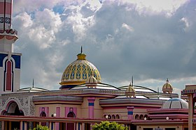


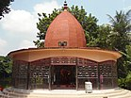
History
The early history of Barisal district is less well-known. It was likely slowly built over time from silt from the Padma, Jamuna and Meghna Rivers. Barisal was part of the early empires of Bengal like Palas and Senas. A copper plate has been found in present Mehendiganj upazila showing a land grant made to a Brahmin by Keshab Sen. However, the Hindu kings only controlled the northern part of the district, while dense forests covered the southern part and isolated the inhabitants from outside influence.
Barishal

